Slide 1
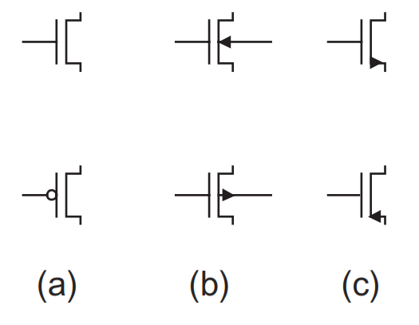
MOS Transistor Theory
Metal-Oxide-Semiconductor (MOS)
MOS transistor was introduced in terms of its operation as an ideal switch.
The performance and power of a chip depend on the current and capacitance of the transistors and wires.
Fig: MOS transistor symbols

Slide 2
MOS Transistor Theory
What is Metal-Oxide-Semiconductor (MOS) ?
The MOS transistor is a majority-carrier device in which the current in a conducting channel between the source and drain is controlled by a voltage applied to the gate.
In an nMOS transistor, the majority carriers are electrons.
In a pMOS transistor, the majority carriers are holes.

Slide 3
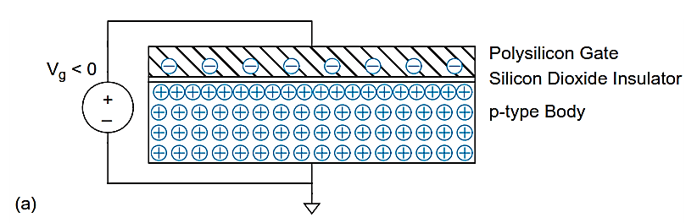
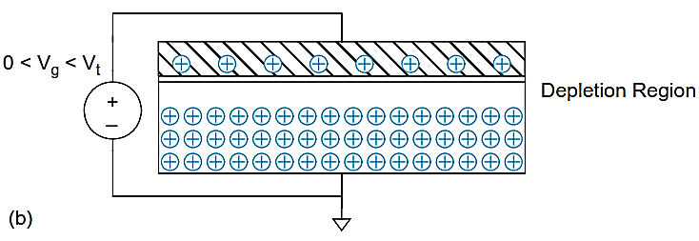
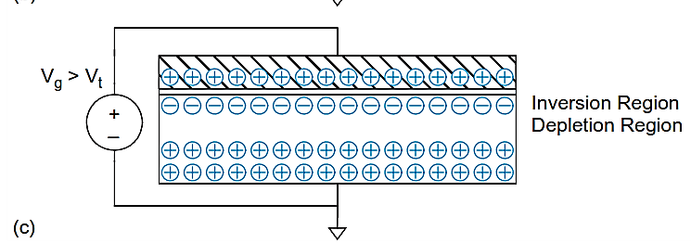
Simple MOS Structure
The top layer of the structure is a good conductor called the gate.
Early transistors used metal gates. Transistor gates soon changed to use polysilicon.
The middle layer is a very thin insulating ﬁlm of SiO₂ called the gate oxide.
The bottom layer is the doped silicon body.
The Figure shows a p-type body in which the carriers are holes. The body is grounded and a voltage is applied to the gate.
FIG. MOS structure demonstrating (a) accumulation, (b) depletion, and(c) inversion

Slide 4
MOS Transistor Theory
Operating modes
Accumulation
Depletion
Inversion
A negative voltage is applied to the gate, so there is negative charge on the gate.
Positively charged holes are attracted to the region beneath the gate.
This is called the accumulation mode.

Slide 5
MOS Transistor Theory
Operating modes
A small positive voltage is applied to the gate, resulting in some positive charge on the gate.
The holes in the body are repelled from the region directly beneath the gate, resulting in a depletion region forming below the gate.

Slide 6
MOS Transistor Theory
Operating modes
A higher positive potential exceeding a critical threshold voltage V_{t} is applied, attracting more positive charge to the gate.
The holes are repelled further and some free electrons in the body are attracted to the region beneath the gate.
This conductive layer of electrons in the p-type body is called the inversion layer.
The threshold voltage depends on the number of dopants in the body and the thickness of the oxide. It is usually positive.

Slide 7
Terminal Voltages (nMOS)
Mode of operation depends on V_{g}, V_{d}, V_{s}
V_{gs} = V_{g} – V_{s}
V_{gd} = V_{g} – V_{d}
V_{ds} = V_{d} – V_{s} = V_{gs} – V_{gd}
Source and drain are symmetric diffusion terminals
By convention, source is terminal at lower voltage
Hence V_{ds} ≥ 0
nMOS body is grounded. First assume source is 0 too.
Three regions of operation
Cutoff
Linear
Saturation

Slide 8
nMOS : Cutoff region
In Figure, the gate-to-source voltage V_{gs} is less than the threshold voltage.
The source and drain have free electrons. The body has free holes but no free electrons.
The junctions between the body and the source or drain are zero-biased or reverse-biased, so little or no current ﬂows.
So, the transistor is OFF, and this mode of operation is called cutoff.

Slide 9
nMOS : Linear region
The gate voltage is greater than the threshold voltage. Now an inversion region of electrons (majority carriers) called the channel connects the source and drain, creating a conductive path and turning the transistor ON. The number of carriers and the conductivity increases with the gate voltage.
When a small positive potential V_{ds} is applied to the drain current I_{ds} ﬂows through the channel from drain to source. This mode of operation is termed linear.

Slide 10
nMOS : Saturation region
If V_{ds} becomes sufﬁciently large the channel is no longer inverted near the drain and becomes pinched off.
Conduction is still brought about by the drift of electrons under the inﬂuence of the positive drain voltage.
As electrons reach the end of the channel, they are injected into the depletion region near the drain and accelerated toward the drain. This mode is called saturation.

Slide 11
MOSFET Threshold Voltage
Threshold voltage (V_{t}) of a MOSFET is defined as the gate voltage with respect to the source terminal at which the inversion layer is formed underneath the gate oxide layer.
To derive the expression for the threshold voltage, we identify the components of the gate voltage required to create the inversion layer under strong inversion as shown below:
The difference between the work function of the gate and channel
The voltage required to create strong inversion
The voltage required to offset the depletion layer charge
The voltage required to offset the fixed oxide charge

Slide 12
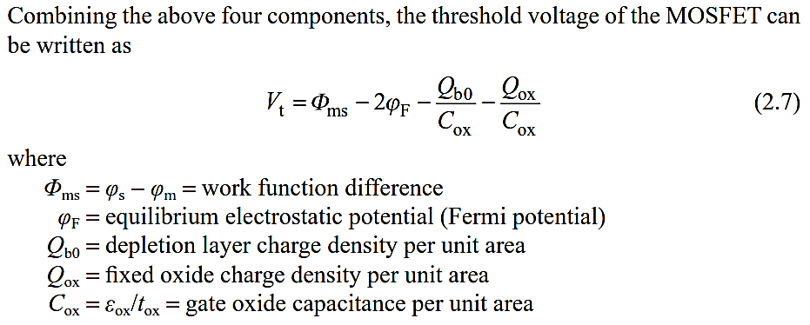
MOSFET Threshold Voltage

Slide 13
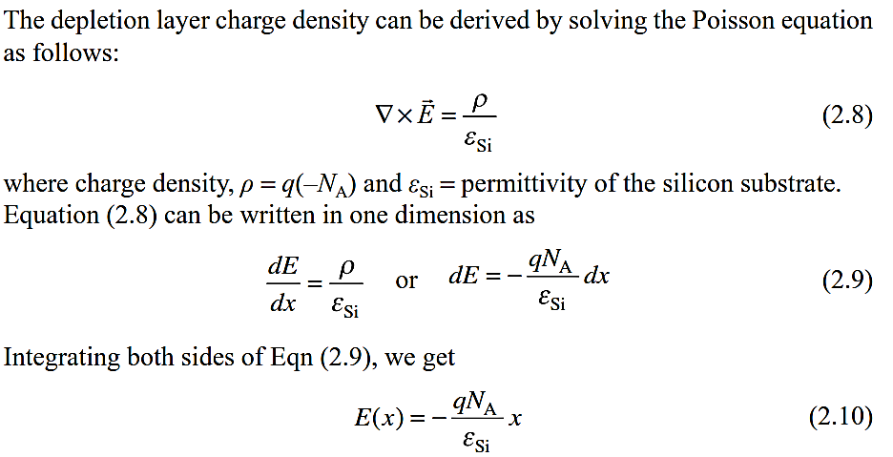
MOSFET Threshold Voltage

Slide 14
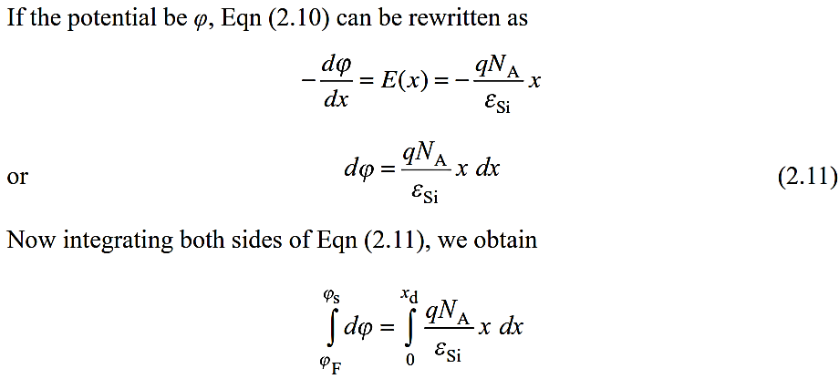
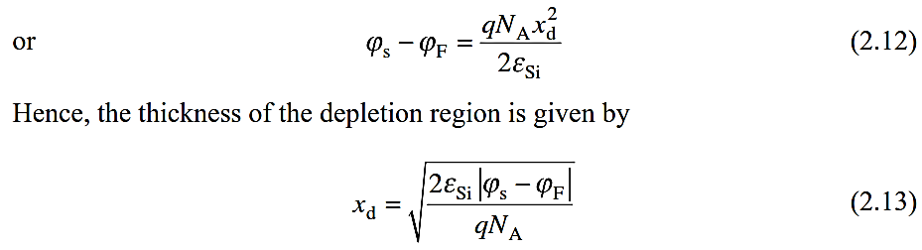
MOSFET Threshold Voltage

Slide 15
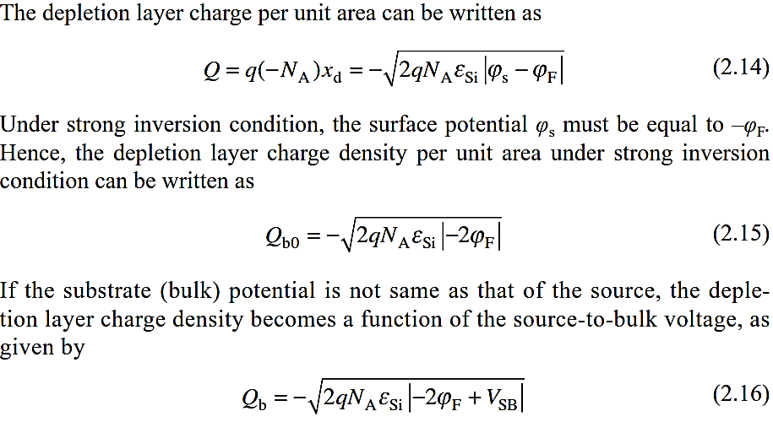
MOSFET Threshold Voltage

Slide 16
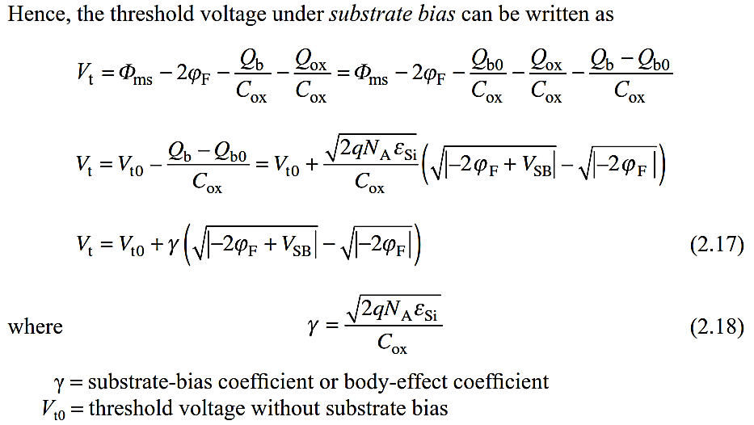
MOSFET Threshold Voltage

